Slide 1

BB84 Quantum Key Distribution Prototype
Research Prototype by SEMA TEAM Qiskit Hackathon 2025

Slide 2
TEAM MEMBERS
MARK ALEX
SAIDUL NAYAN
ESAM AL-SHAMERI
AYMEN SLAMA

Slide 3
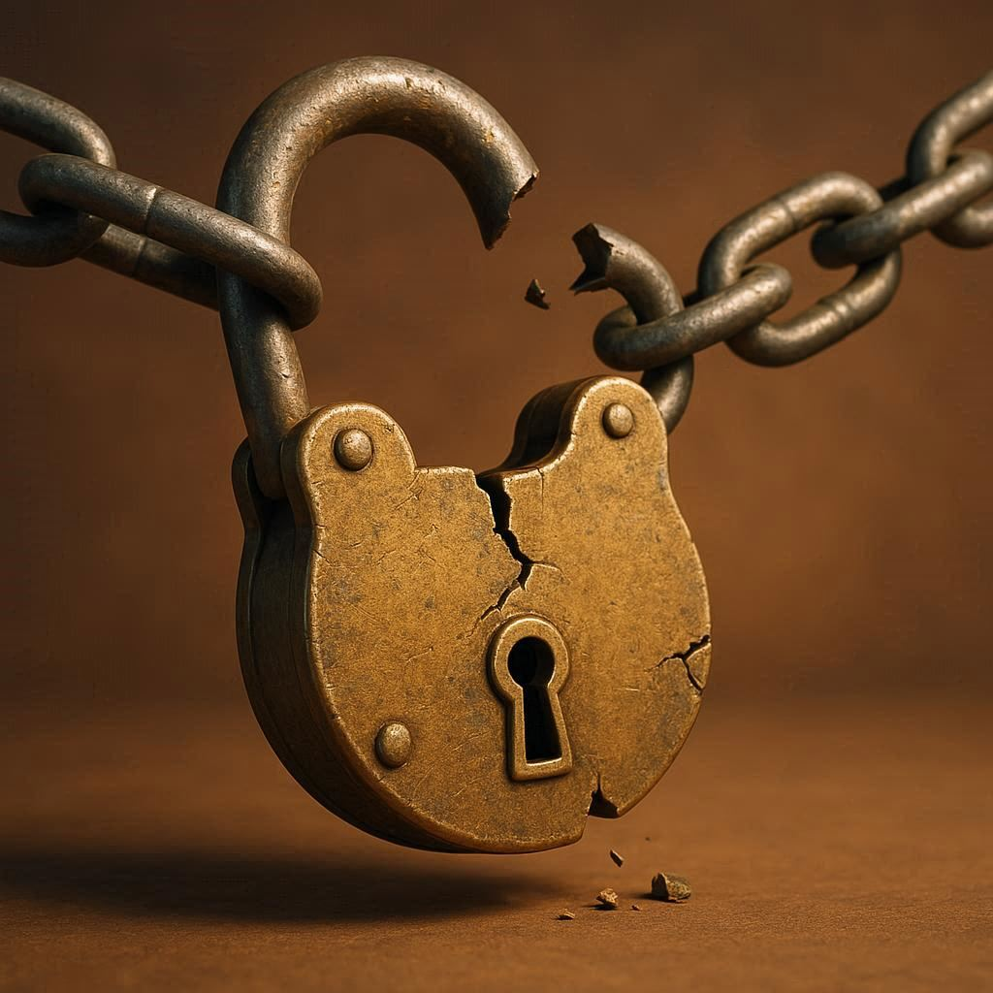
The Challenge
Classical key distribution is vulnerable to future quantum computers.
Need secure, quantum-safe methods for key exchange.
Traditional BB84 works but lacks adaptability for modern, noisy, and hybrid networks.

Slide 4
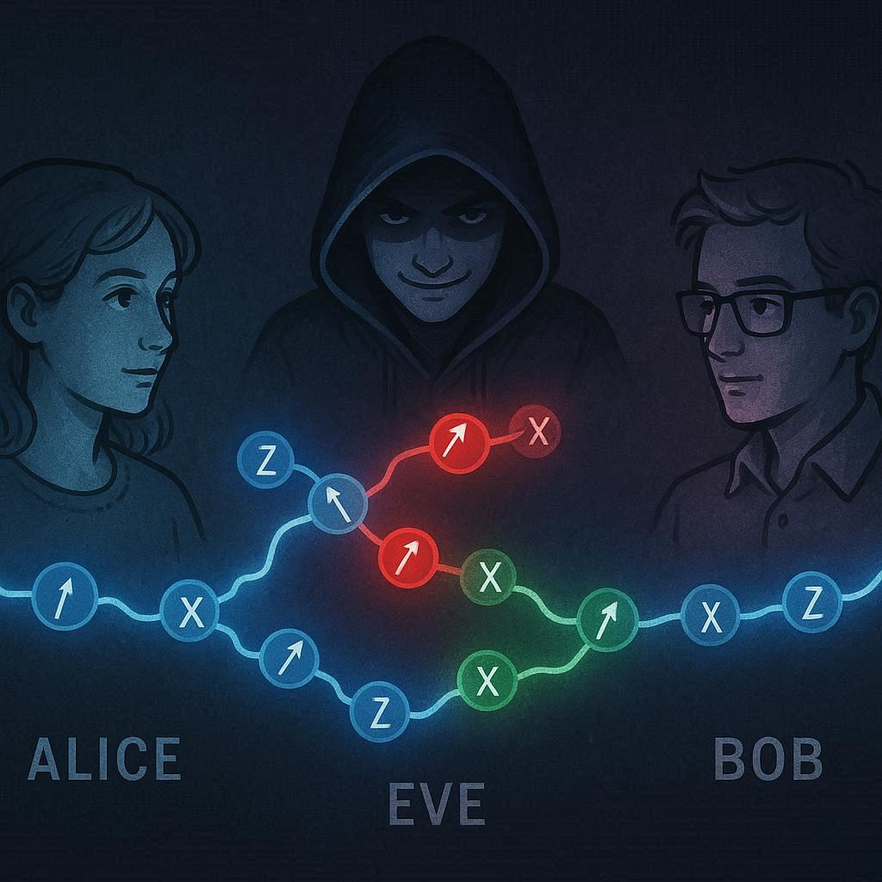
Our Solution
Adaptive Bias Control in BB84
Adaptive Bias Control in BB84: This makes the protocol smarter and more secure, since it can adapt in real time to possible attacks instead of staying static.
RSA (or other public-key cryptography) ensures that Alice and Bob are who they claim to be.
QKD (BB84) ensures that the key they share is secret and eavesdropper-free.
Delayed measurement architecture (simulated).

Slide 5
System Overview
Alice prepares random qubits (Z/X bases).
Bob measures in random bases.
Eve (optional) intercepts and resends to simulate attack.
Post-Processing: Basis reconciliation, sifting, QBER analysis.
Output: Secure sifted key + automated security assessment.

Slide 6

Novel Feature
Adaptive Bias Control in BB84
In our version of the BB84 protocol, we added an adaptive bias feature.
Normally, Alice chooses between two measurement bases (Z and X) completely at random. But in our system, we monitor the QBER (error rate) over time.
If the QBER stays low → the system may slightly favor one basis for efficiency.
If the QBER rises → the system automatically returns to a balanced 50–50 basis choice to reduce predictability and detect eavesdropping faster.
This makes the protocol smarter and more secure, since it can adapt in real time to possible attacks instead of staying static.

Slide 7
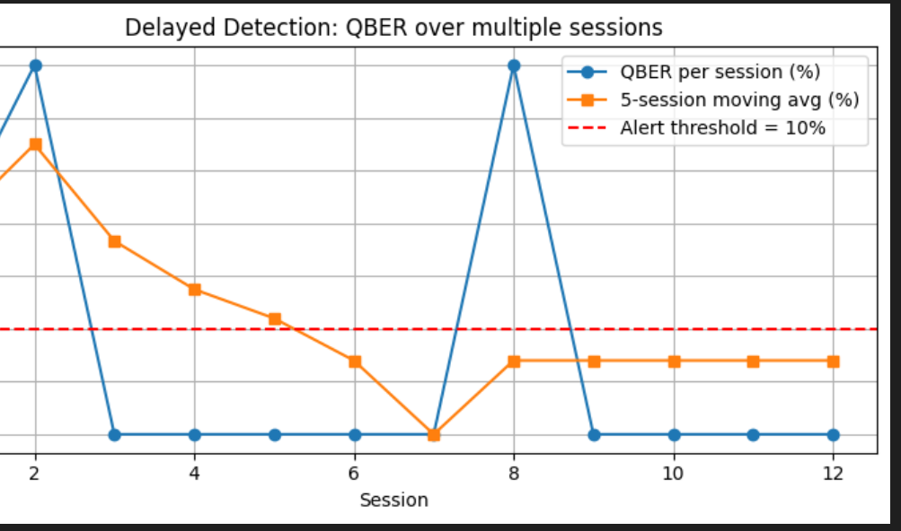
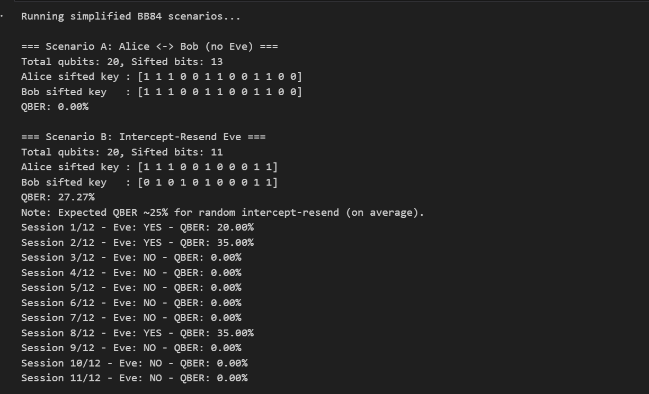
Results Snapshot

Slide 8
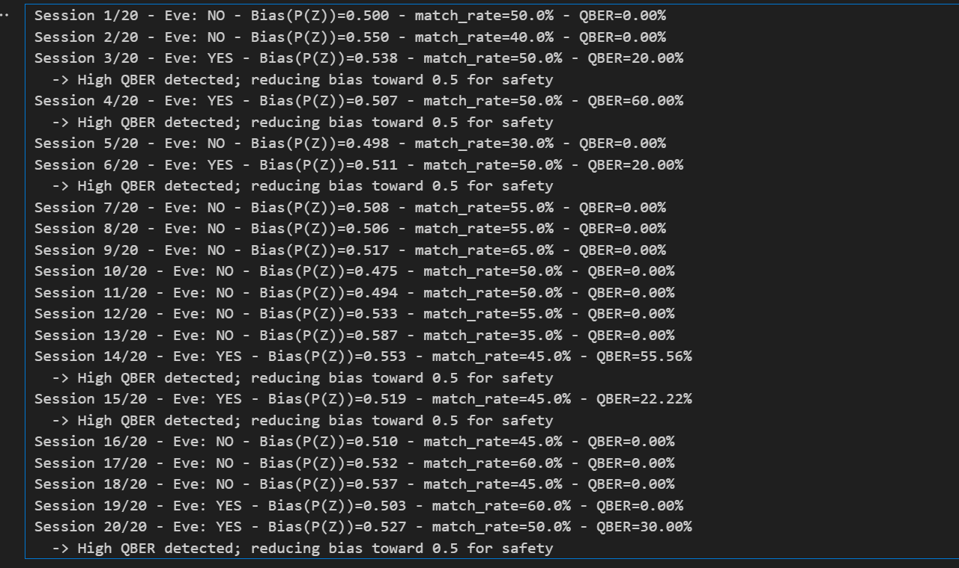
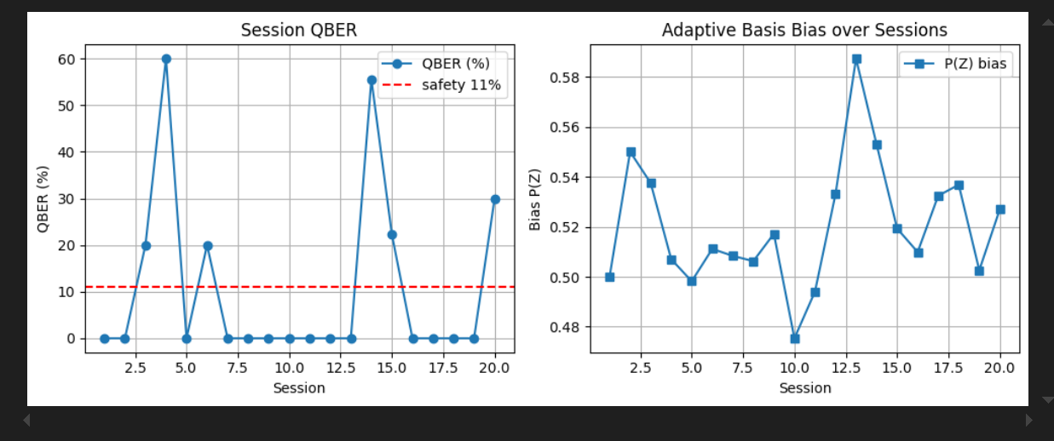
Results Snapshot

Slide 9
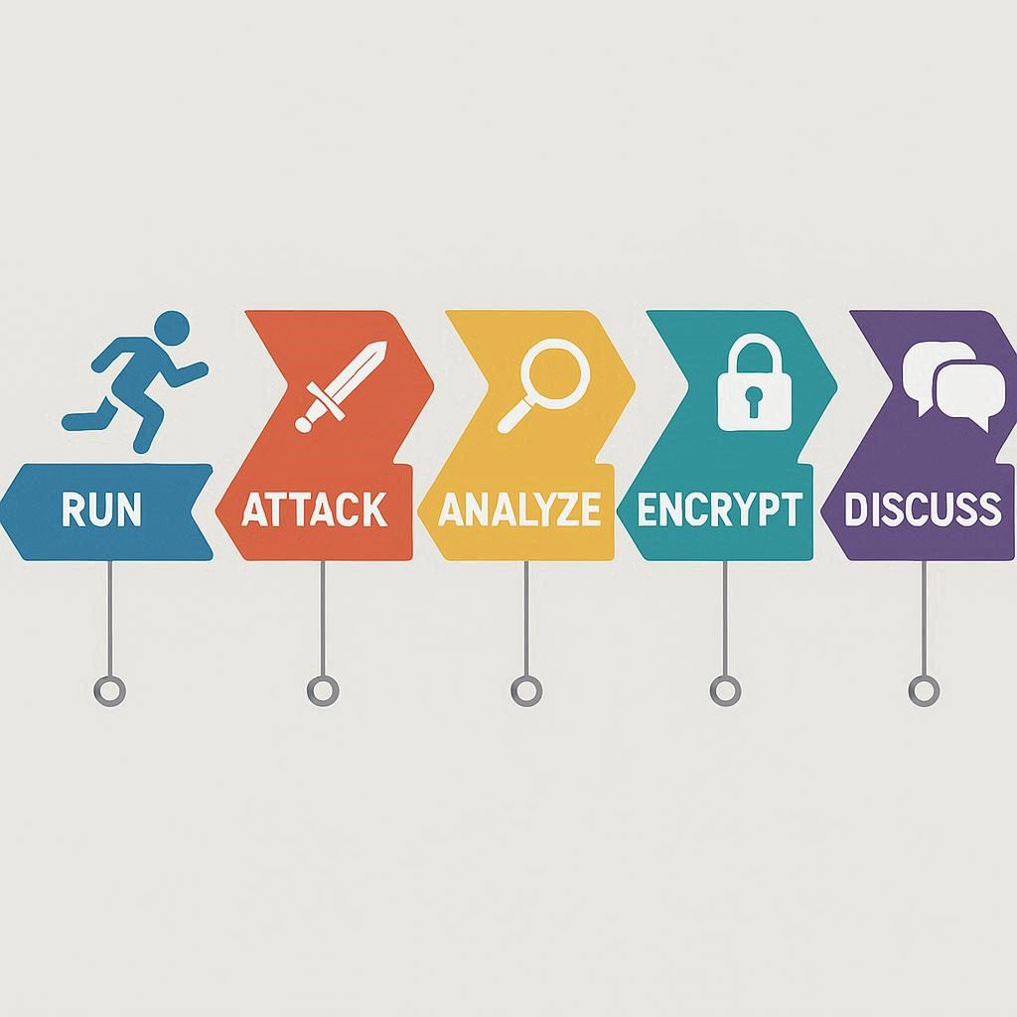
Demonstration Flow
Run baseline protocol (no Eve).
Run intercept-resend scenario.
Observe QBER spike & automatic alert.
Show OTP encryption using secure key.
Discuss noise model & delayed measurement simulation.

Slide 10
Integrating Quantum-Inspired Security into Mechatronic Systems
Adaptive Bias Control Enables controllers to adjust sensor fusion weights, sampling rates, and actuation modes in real time — improving resilience against faults and cyber-attacks.
1
Hybrid Authentication (RSA + QKD) RSA verifies device identities, while BB84-based QKD (or its simulation) continuously refreshes symmetric keys for encrypted control communication.
2
Delayed Measurement Architecture Critical commands or sensor data are acted on only after integrity and authentication checks, preventing spoofed or corrupted signals.
3

Slide 11

Future Work
Implement true delayed-measurement on quantum hardware.
Add privacy amplification and error correction.
Integrate Quantum LSTM (QLSTM) for adaptive intrusion detection.
Run on IBM Eagle / Brisbane backends for validation.

Slide 12

A Quantum-Safe Communication for Tomorrow
THANK YOU

